Slide 1
Introductory General Chemistry
Chemistry 3A
Course Administration & Policies
S. M. Halloran

Slide 2
Communication Plan
All projects—like your success in this course—write out a communication plan
This is about what and how to communicate to move the project along
What to communicate
Asking about how to solve a problem, understanding details of an assignment, when is a deadline
Helping each other with reminders, setting up an interactive meeting online or in person
How to communicate
Email, phone text or a call
Canvas online system

Slide 3
Recommendations for Successful Performance in Chem 3A
Syllabus
The syllabus is your friend, your map to how the course is supposed to go
Understand it well: generally, answers questions of highest importance to students
Broad overview or outline of course content
Materials for course: freely accessible online “book”, lab gear (coat + goggles), scientific-grade calculator
Grading: components of performance in course
Examinations: midterms and final, quizzes
“Homework”:
Laboratory part of course: reports of experiments

Slide 4
Recommendations for Successful Performance in Chem 3A
Online Systems/Tools
Canvas
Announcements – look for this regularly
Course Home Page
Quizzes
In-Class Exercises
Real quizzing
Assignments
Discussions
Chat
Interaction between instructor & student(s)
Part-time instructors interact through Canvas and email
Email: Mitch.Halloran@fresnocitycollege.edu

Slide 5
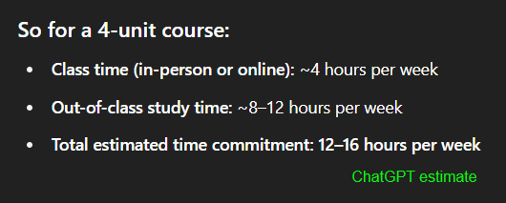
Recommendations for Successful Performance in Chem 3A
Attendance
Being at lecture & certainly being in the lab is not optional: attendance is recorded
Time Commitment
Reading, homework, study for exams/quizzes
Generally thought to be at least twice time/effort commitment of the hours (units) of lecture+lab: 4 units → 8-12 hours additional per week

Slide 6
Teamwork
Throughout your career, you will learn that projects and programs have teams of people in order to get work done successfully.
While tasks in projects are done by individuals performing roles as part of the team, the overall work is a product of the team
The “project” here at FCC in this course is learning chemistry, so everyone will be part of a team
This team is your study group

Slide 7
The Study Group
The Canvas LMS app was used to randomly group students into study groups in this course
The study group is only one facet of your learning process, intended to initiate you into being part of a team in your learning goal
Your instructor (me), your peers, resources of the College (tutors, tutoring services, counselors, other support staff) are always ready & present too

Slide 8
Artificial Intelligence in Learning & Academics
The elephant in the room? Have you been talking about it in your course of learning?
Will be transformative, but…
useful to you IF you use it properly
ChatGPT/Bing CoPilot/Gemini don’t initiate the “what if” and “why” that drives discovery and exploration
A.I. does not and will not replace humans in asking questions that push discovery
Learning the foundations of a discipline—that is, getting that Associates or Bachelors or Doctoral degree—makes you that better thinker who is asking “what if” and “why”
Doing that “homework”…
Helps you pass the test, yes
But also builds you as a discoverer, explorer, researcher, thinker

